Slide 1
Chapter 1
Entrepreneurship
and the
Entrepreneurial Mind-Set
McGraw-Hill/Irwin
Copyright © 2013 by The McGraw-Hill Companies, Inc. All rights reserved.

Slide 2
The Nature of Entrepreneurship
Entrepreneurial opportunities
  Situations in which new goods, services, raw materials, and organizing methods (example: 1-click purchase at Amazon):
    Can be introduced
    Sold at greater than their cost of production
Entrepreneurial action:
  Involves creation of new products, processes or services
  Involves entry into new markets
  Involves introducing change into the market

Slide 3
How Entrepreneurs Think
Entrepreneurs should:
  Effectuate
  Engage in bricolage
  Cognitively adapt
  Learn from failures

Slide 4
How Entrepreneurs Think
  Causal process vs effectual process
    In causal process the outcome occupies us first
    Causal process focuses on factors that lead to the outcome
    Causal process starts with how and why
    Causal process is instilled by the education process

Slide 5
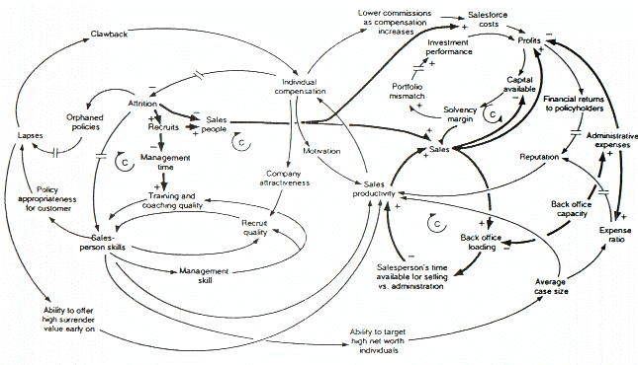
Causal process
Source: https://www.google.com/search?q=causal+process&rlz=1C1KMZB_enUS518US518&es_sm=93&source=lnms&tbm=isch&sa=X&ei=rGj7U6brNsueyATz3YKgDg&ved=0CAgQ_AUoAQ&biw=1517&bih=714&dpr=0.9#facrc=_&imgdii=_&imgrc=3hRE47bcoi6PBM%253A%3B7ssbZ5FCcRwU8M%3Bhttp%253A%252F%252Fupload.wikimedia.org%252Fwikipedia%252Fcommons%252F5%252F52%252FCausal_Loop_Diagram_of_a_Model.gif%3Bhttp%253A%252F%252Fen.wikipedia.org%252Fwiki%252FCausal_loop_diagram%3B645%3B370

Slide 6
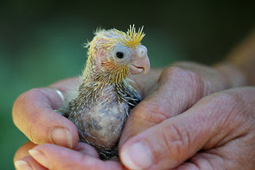
How Entrepreneurs Think
  Effectuation process
    Starts with what one has
    Bird in hand: Starts with what one has
    Selects among possible outcomes that lead to a possible end goal
    Tinkering, using bricolage
    http://media.pearsoncmg.com/ph/streaming/bp/2013/MGMT/Entrep/Entrep2012_Johnny_Financial.html
Source: www.alwaysspanish.com

Slide 7
How Entrepreneurs Think
Bricolage
  Applying combinations of the resources at hand to new problems and opportunities
  Taking existing resources and tinkering and/or reframing them so they can be used in new ways

Slide 8
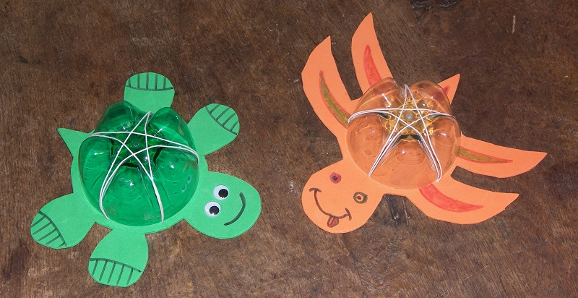
Bricolage- what do you have available?
Source: http://www.jeuxetcompagnie.fr/bricolage-pour-grand-une-tortue/

Slide 9
How Entrepreneurs Think
  Entrepreneurial mind-set: Ability to rapidly sense, act, and mobilize, even under uncertain conditions
  Examples:
  Leverage surprise
    http://www.effectuation.org/video/leverage-surprise-contingency-lemonade-principle

Slide 10
How Entrepreneurs Think
Cognitive adaptability
  Describes the extent to which entrepreneurs are:
    Able to control their thinking and learning process
    Dynamic, flexible, self-regulating and engaged in the process of generating multiple decision frameworks
    Focused on sensing and processing changes in their environments and then acting on them
  Metacognitive awareness - Ability to reflect upon,understand, and control one’s thinking and learning

Slide 11
The Intention to Act Entrepreneurially
Entrepreneurial intentions
  Motivational factors that influence individuals to pursue entrepreneurial outcomes
Entrepreneurial self-efficacy
  Conviction that one can successfully pursue entrepreneurial outcomes
Perceived desirability
  Degree to which a potential entrepreneurial outcome is evaluated as favorable or unfavorable

Slide 12
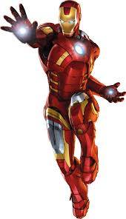

The Intention to Act Entrepreneurially
Perceived social desirability
  Degree to which a potential entrepreneurial outcome
  is evaluated as favorable or unfavorable
Entrepreneurs are generally looked upon positively in the United States.
Source: disney.wikia.com

Slide 13
Entrepreneur Background and Characteristics
Age
  Chronological age – Usually between the ages 22 and 45
Work history
  Past work experience of an individual is often
  very helpful for entrepreneurial endeavours

Slide 14

Discussion questions
2. Do you use effectuation (starting with what you have) in your daily life? What does this concept mean to you?
Is it positive for entrepreneurship?
Can it have drawbacks?

Slide 15
Discussion questions
Is “corporate entrepreneurship” or “intrapreneurship” an oxymoron? Do the characteristics of an established organization , such as its routines and structure, increase the efficiency, but at the same time kill the entrepreneurial spirit?

Slide 16
Discussion questions
Is increasing an entrepreneurial orientation of an established business always a good thing? Or are there circumstances, or environments, in which the further pursuit of opportunities can diminish firm performance?

Slide 17
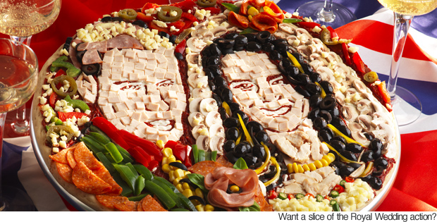
Discussion questions
3. The goal for this exercise is to make you start thinking about various
types of preparations that have to be made before one can start an enterprise.
Your cousin comes to you to borrow
$20 000 to start a business with a product looking like this:
Custom made party platters…
Source: newslite.tv

Slide 18
Discussion questions
3. Looks interesting….
But what questions would you ask him before you decide to borrow him $20 000?
What plan does he have to sell this product?
What are the parts of that plan that you would like to know about?
Source: newslite.tv

